Slide 1
Mathematics Education 14 Apr 2017

Slide 2
Has Math Education been failing thousands of students?
Looking at the NAEP (National Assessment of Educational Progress) trends show that math education has not been failing thousands of students… At least not until 2015.

Slide 3
The following slides will show NAEP Score trends from 1973 to 2012.

Slide 4
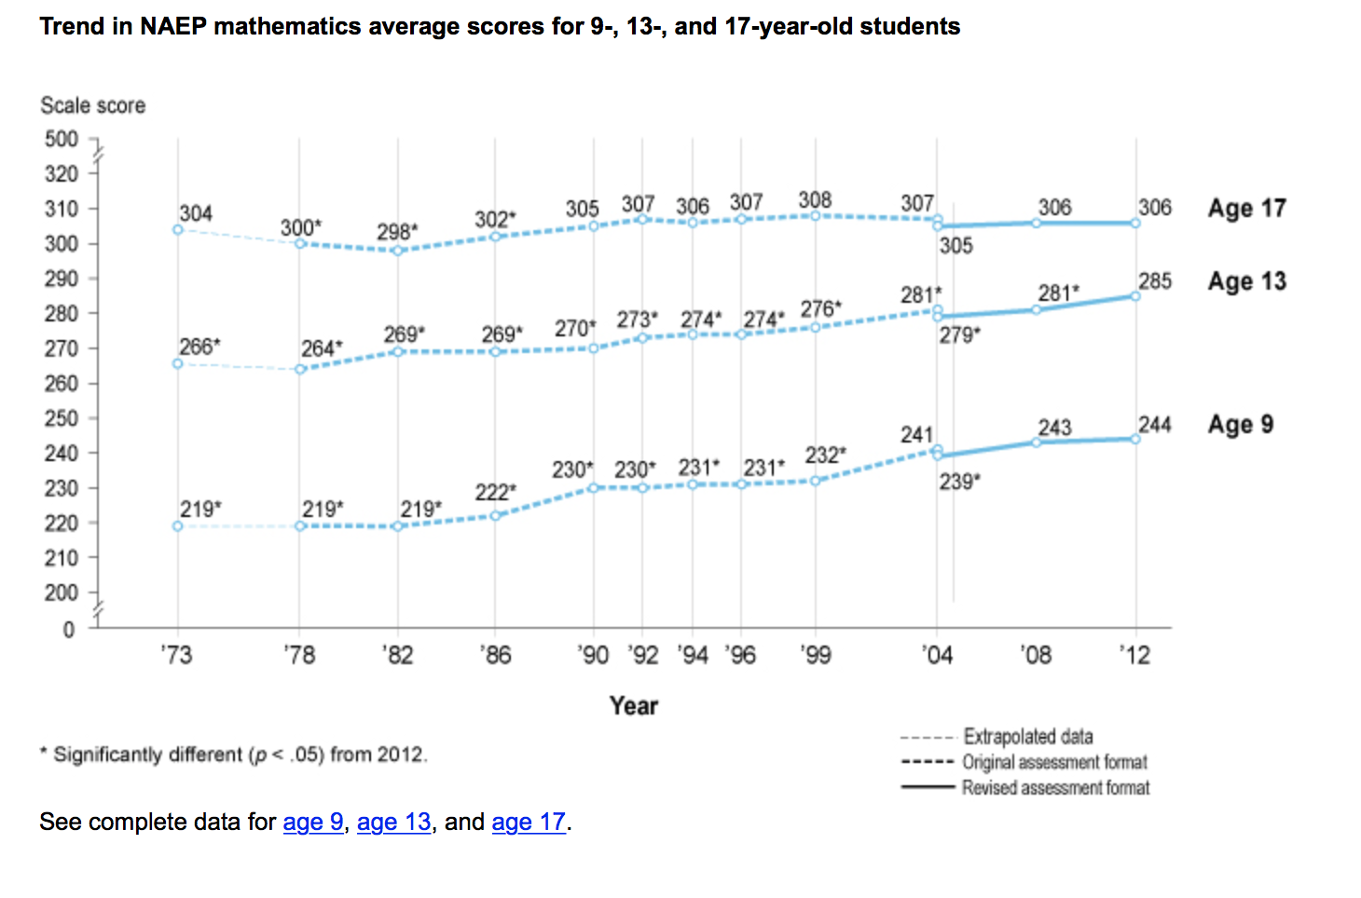

Slide 5
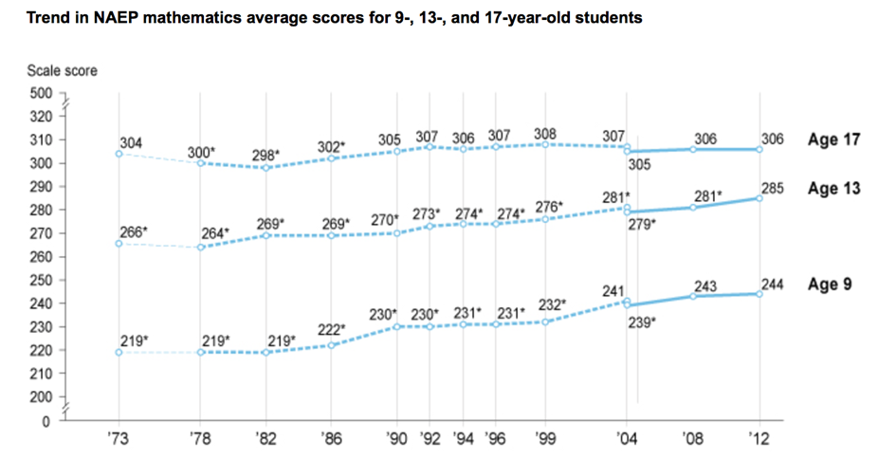
Notice the trends show a slow steady increase for ages 9 and 13.

Slide 6
Now let’s look at NAEP comparisons from 2013 to 2015.

Slide 8
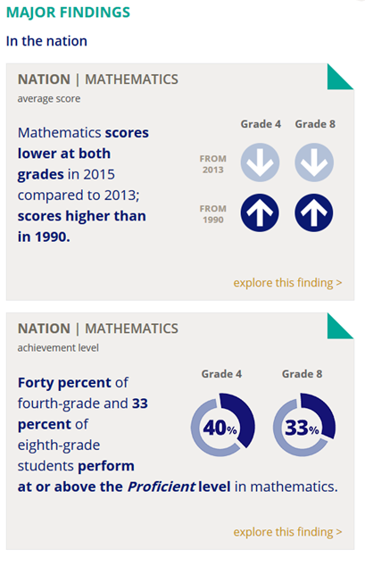
Test Scores are down in grades 4 and 8.
40% of 4th graders and 33 % of 8th graders are at or above Proficient Levels

Slide 9
How does Texas compare to the rest of the Nation?

Slide 10
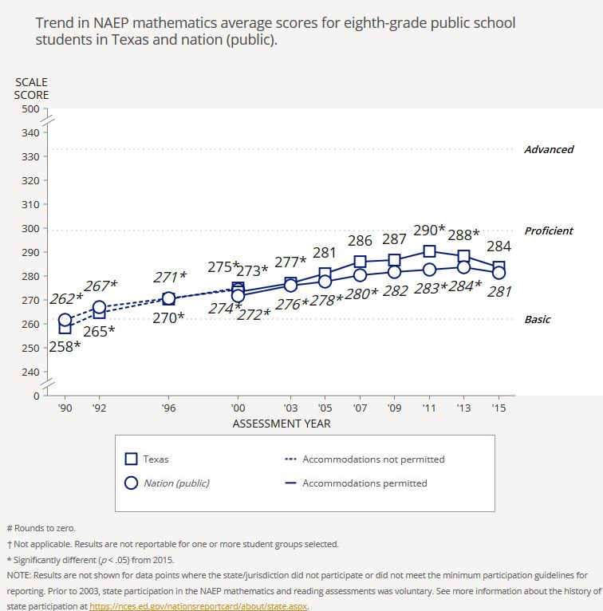
8th grade NAEP scores from 1990 to 2015 Texas versus Nation.

Slide 11
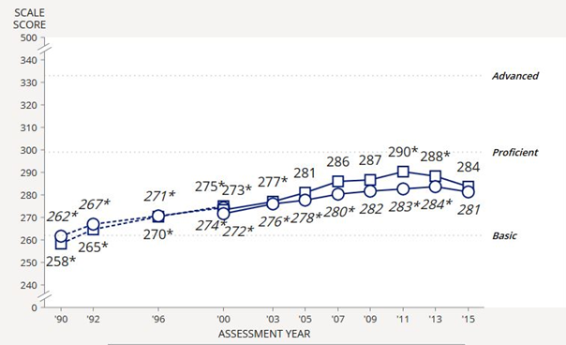
8th grade NAEP scores from 1990 to 2015 Texas versus Nation.
Texas is dropping faster than the rest of the Nation!

Slide 12
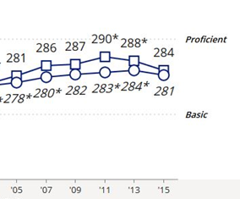
8th grade NAEP scores from 1990 to 2015 Texas versus Nation.
It is the tangent to the curve that indicates that Texas really has a problem.

Slide 13
8th grade NAEP scores from 1990 to 2015 Texas versus Nation.
This downturn in test scores is because of the reform math (Common Core) that made it into the 2012 TEKS.

Slide 14
Dr. Milgram discusses NAEP scores at Texas State Board of Education.

Slide 15
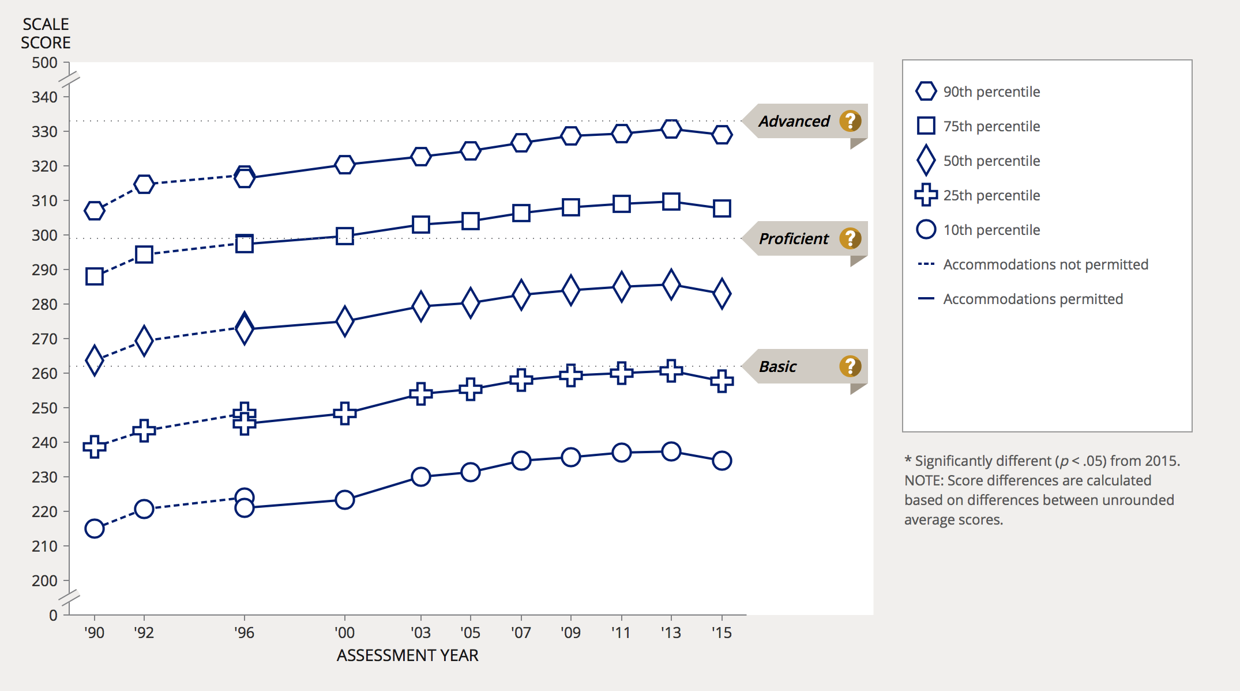
8th grade NAEP scores from 1990 to 2015 by percentile.

Slide 16
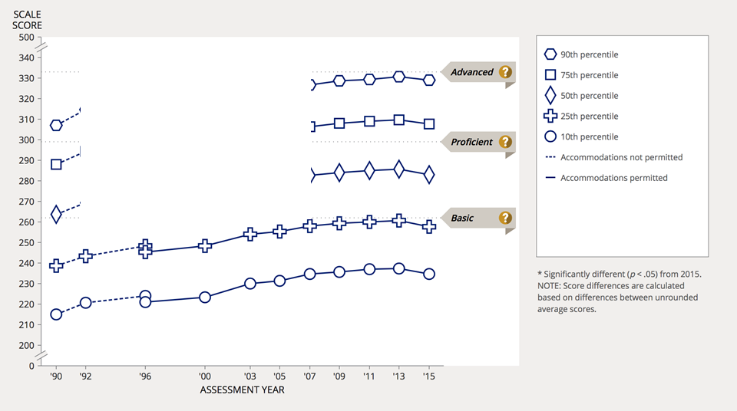
8th grade NAEP scores from 1990 to 2015 by percentile.
Notice all levels are affected.

Slide 17
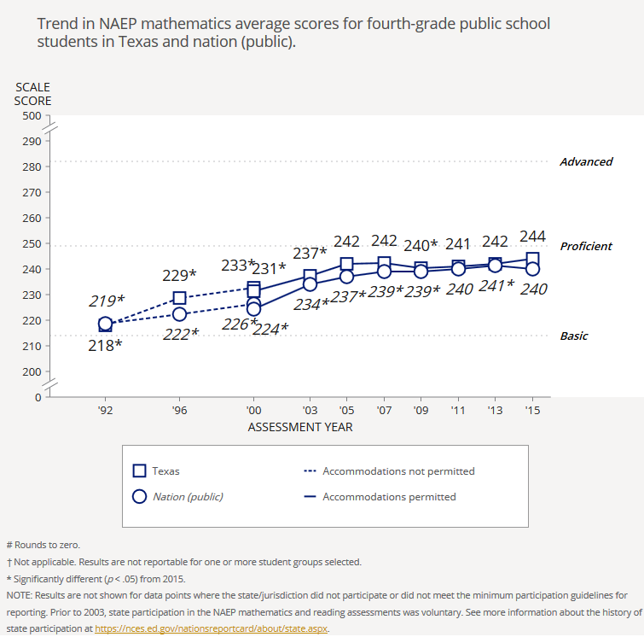
4th grade NAEP scores from 1990 to 2015 Texas versus Nation.

Slide 18
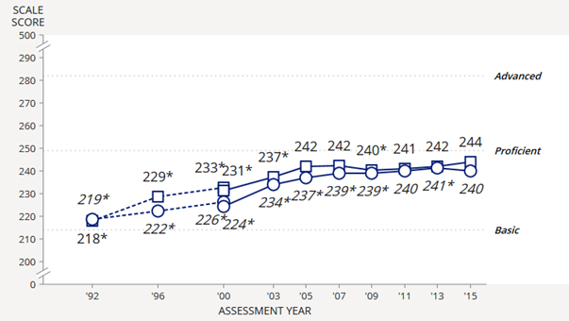
4th grade NAEP scores from 1990 to 2015 Texas versus Nation.

Slide 19
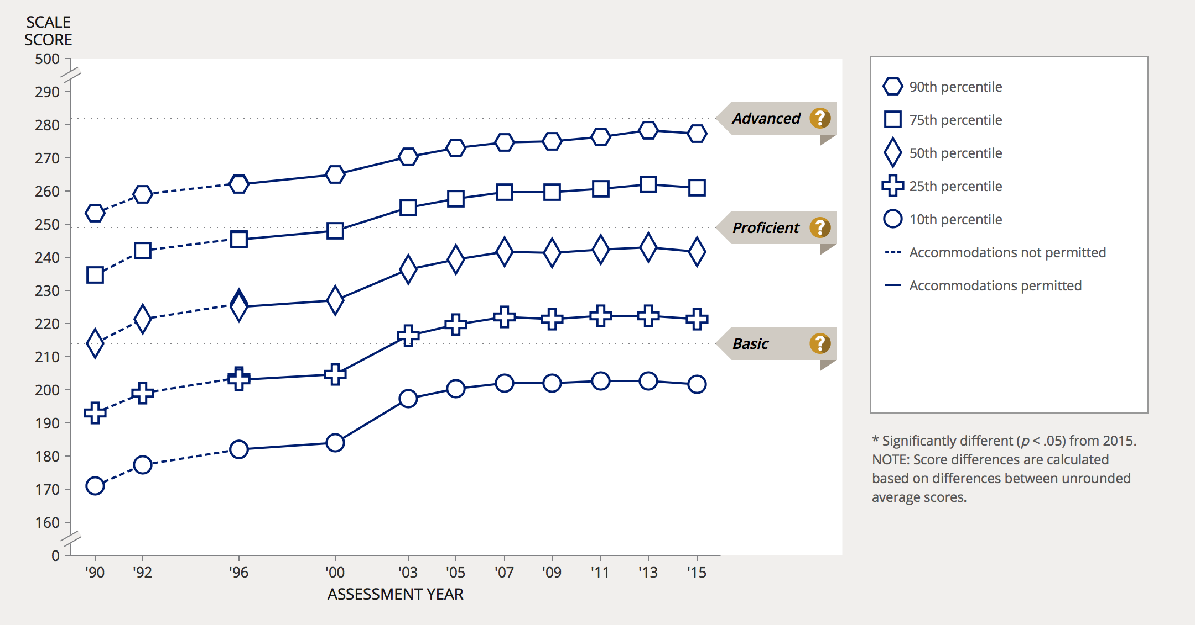
4th grade NAEP scores from 1990 to 2015 by percentile.

Slide 20
Most mathematicians (not math educators) think the downturn in NAEP Scores, the first in 40 years, is because of Common Core.

Slide 21
Let’s look at STAAR scores. The following charts were created from data from the ‘Raw Score Conversion Tables’ files on the TEA Website. http://tea.texas.gov/student.assessment/staar/convtables/

Slide 22
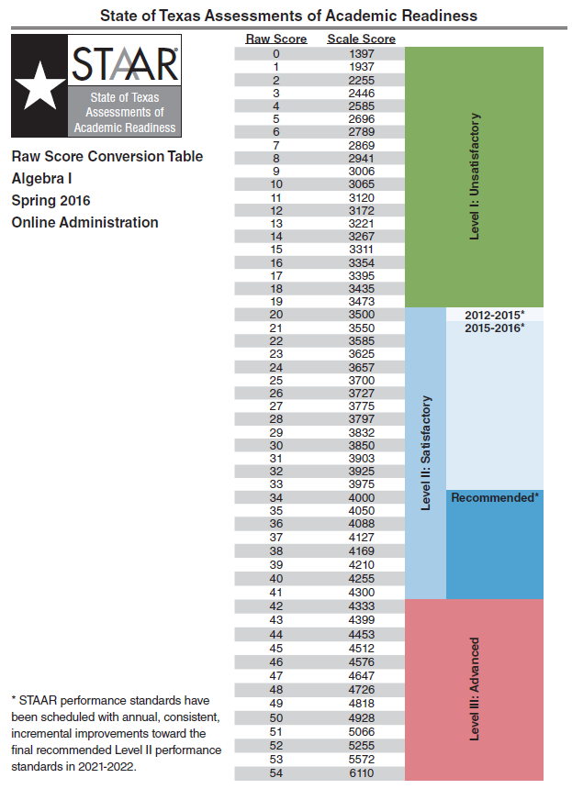
Here is the STAAR Raw Score Conversion Table for Spring 2016 Algebra I.

Slide 23
20/54 = 0.37
37% is considered a passing score!

Slide 24
20/54 = 0.37
37% is considered a passing score!
How much does a student know if a 37% is considered passing?

Slide 25
The following charts show the minimum passing scores in percent for math grades 3-8, Algebra I, Geometry and Algebra II for the past 5 school years.

Slide 28
I ask again, how much does a student really know with passing grades so low?

Slide 29
How is math being taught in Texas?

Slide 31
Common Core math seems so nonsensical… But so does math in Texas, a state that outlawed Common Core with HB642. What many parents did not know is that Texas was revising the state standards (TEKS) to be the same as Common Core.

Slide 32
The 2012 Math TEKS put more of an emphasis on the “Process” of getting an answer and less emphasis on getting the correct answer. The next slides will show how multiplication is being taught in many districts in Texas.

Slide 33
Multiplication by 6. We used to remember multiplication math facts. Now the students have to learn these methods….

Slide 35
The Common Core “Process” of multiplication turns a simple problem into a three step problem…

Slide 36
Multiplication by 5 is just as bad...

Slide 38
The TEKS also call for modeling. One particularly useless manipulative is the Algebra Tile.

Slide 40
What do these tiles look like for a 3rd order polynomial? They would be three dimensional. What about a 4th order polynomial or higher? Or, what happens when the coefficients are not whole numbers?

Slide 41
Here is another example of modeling in 5th grade… This example was taken from the 2016 STAAR.

Slide 42
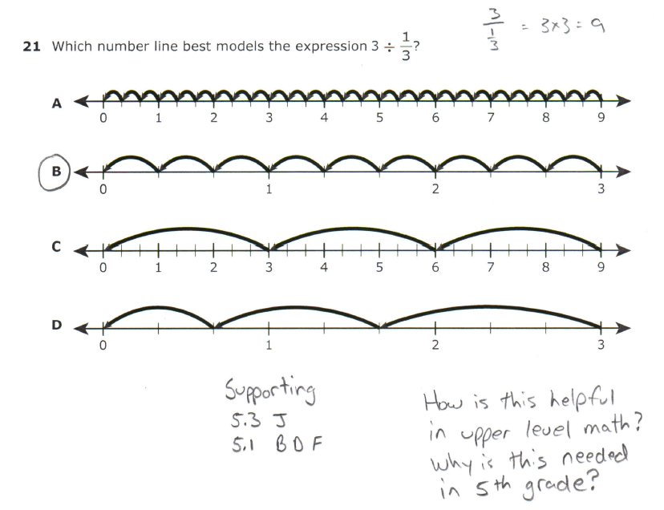
Do you know anyone who use a number line to solve this problem?

Slide 43
5th Graders must be taught this method because of the wording in the content standard.
TEK 5.3 J states: (Supporting Content Standard)
(3) Number and operations. The student applies mathematical process standards to develop and use strategies and methods for positive rational number computations in order to solve problems with efficiency and accuracy. The student is expected to:
(J) represent division of a unit fraction by a whole number and the division of a whole number by a unit fraction such as 1/3 ÷ 7 and 7 ÷ 1/3 using objects and pictorial models, including area models;
Because of all of the emphasis on “Process” and multiple methods there is no automaticity…

Slide 44
Here is another example of modeling. This was from Leander ISD 8th grade math resources (from 2015). Do 8th graders need to draw pictures to understand Algebra concepts?

Slide 45
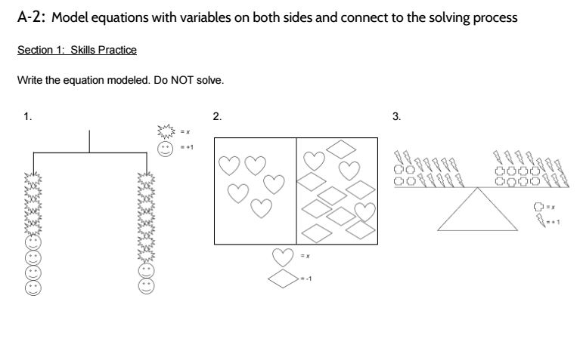

Slide 46
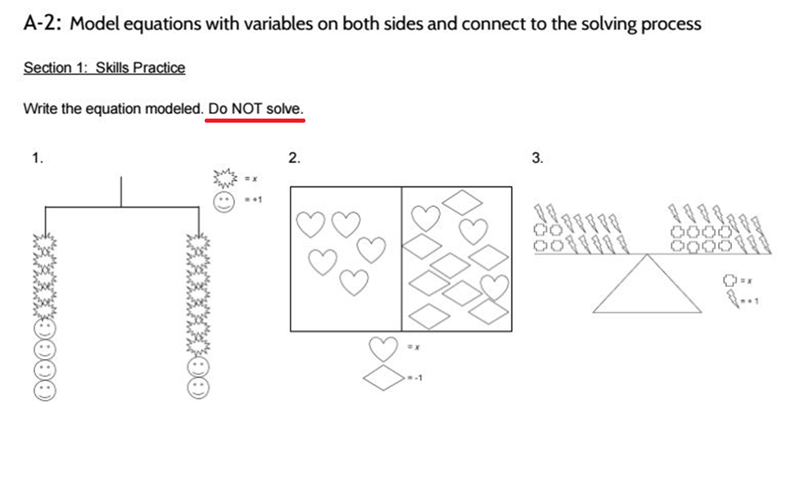

Slide 47
A parent from Katy ISD shared a problem involving a number line to teach multiplication. This is what happens when too much emphasis is placed on the “Process” or method of solving a problem…

Slide 48
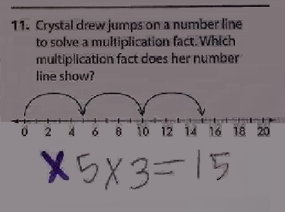
The only answer that the teacher would accept as correct for this problem is 3x5=15. 5 x 3 was treated as incorrect!

Slide 49
That is the problem with poorly defined TEKS. Students and teachers may recognize a model or represent something on a number line, yet miss the fact that with the commutative property of multiplication, order does not matter and 5x3 and 3x5 both equal 15! They are missing the bigger picture.

Slide 50
Dr. Milgram’s comment on multiple processes or methods to solve a problem.

Slide 51
The next example is from the 2015 5th Grade STAAR. Notice that the problem does not require a calculation. The student only has to recognize the model.

Slide 53
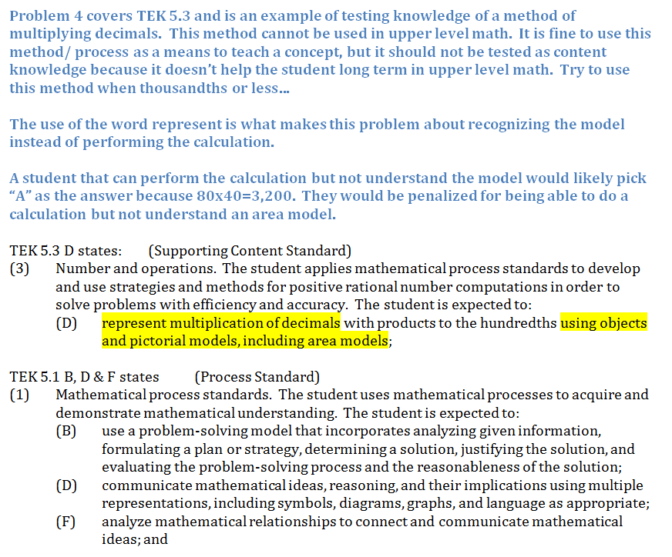

Slide 54
The next example is from the 2015 6th Grade STAAR. Notice that the problem does not require a calculation. The student only has to recognize the model.

Slide 55
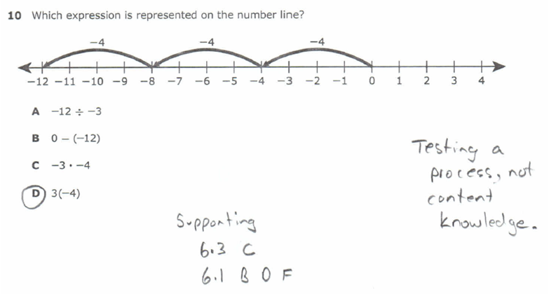

Slide 57
The next example is from the 2015 3rd Grade STAAR. This is an example of a good problem, but look how the TEK is worded and what could have been tested.

Slide 58
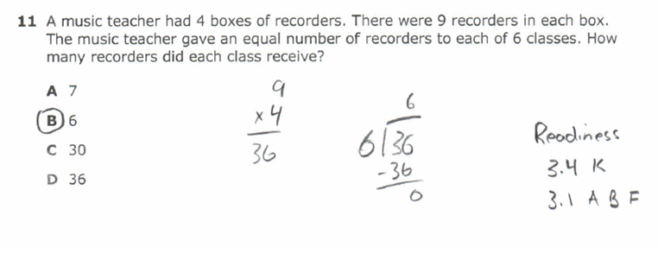

Slide 60
It is this wording in the content portion of the standards that needs to be removed. Removing the Process Standards alone will not fix the problem with the TEKS. You must remove the embedded process standards.

Slide 61
The next example is from the 2015 7th Grade STAAR. Do 7th grade students need models to solve Algebra? Only if models are how they have been taught instead of a good foundation in math!

Slide 64
The next example is from the 2015 5th grade STAAR.

Slide 65
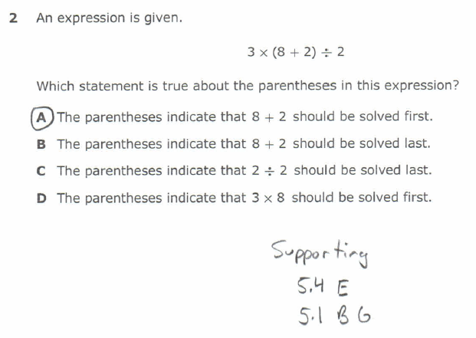
Wouldn’t solving the problem show the students understands order of operations?

Slide 66
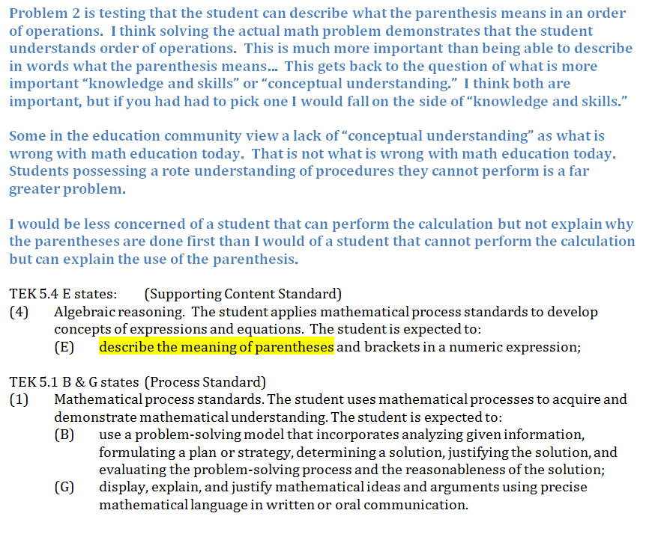

Slide 67
Here is what Dr. Milgram says about having methods called out in the TEKS.

Slide 68
There is too much focus on the Process Standards. The Process Standards distort the picture on math instruction. The TEKS should not call out lists of methods. Content knowledge is the key!

Slide 69
Texas standards are already gutted! Should the Process Standards be removed? Here is what Dr. Milgram says about the Standards and how the Process Standards are a problem:

Slide 70
Math standards are already gutted.

Slide 71
Removing the process standards alone will not fix the problem. In the following video Dr. Milgram describes how the process standards are deeply embedded in the standards.

Slide 72
Process Standards are deeply embedded.

Slide 73
The lists of methods called out in each sub standard are the pieces that tie into the process standards. These methods tell the teacher how to use the process standards to have the students understand a topic.

Slide 74
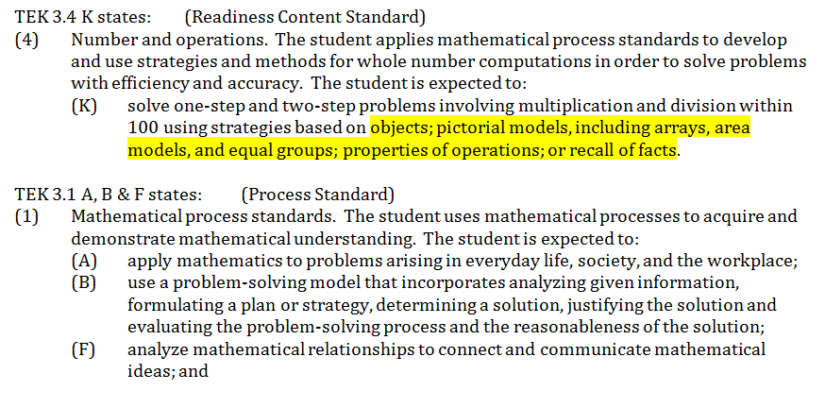
The highlighted portion of TEK 3.4 K below is an example of this deep embedding of the process standards.

Slide 75
Math Process Standards: What is the origin? What is the purpose? Is there any research that shows they work?

Slide 76
Process Standards: Origin, Purpose, Research that shows they work…

Slide 77
The next table shows the percentages of problems on the STAAR that only testing a Process or a specific method.

Slide 78
Grade | Total # of Questions | % of Questions Testing Process in 2015 (based on # of questions released) | % of Questions Testing Process in 2016 | Time to complete
3 | 46 | 28% | 28% | 32:57
4 | 48 | 13% | 25% | 43:35
5 | 50 | 30% | 22% | 43:24
6 | 52 | 23% | 13% | 59:40
7 | 54 | 25% | 9% | 1:12:06
8 | 56 | 22% | 9% | 1:09:16
Algebra I | 54 |  |  | 1:07:19

Slide 79
The math expert that advises the SBOE (the one Mrs. Hardy spoke of during the 16 Nov 2016 meeting) is Dr. Paul Gray. Dr. Gray works for Cosenza & Associates.

Slide 80
He wrote a textbook on Algebraic Reasoning.

Slide 81
Dr. Gray stands to profit off of the reform math he is promoting.
This course is only needed because so few are prepared for Algebra…

Slide 82
Dr. Gray is not a mathematician... He has a masters degree in mathematics education.

Slide 83
TASM’s Jerri LaMirand advised the SBOE to get input from Dr. Jo Boaler. Dr. Milgram warned about getting help from education experts. Dr. Boaler falls into this category.

Slide 84
Dr. Milgram warned against experts with close ties to the education schools.

Slide 85
Dr. Boaler is a Stanford Professor of Math Education (from the Education Department, not a Mathematician.) She also stands to profit from the reform math she supports. She founded youcubed.org and sells professional development.

Slide 87
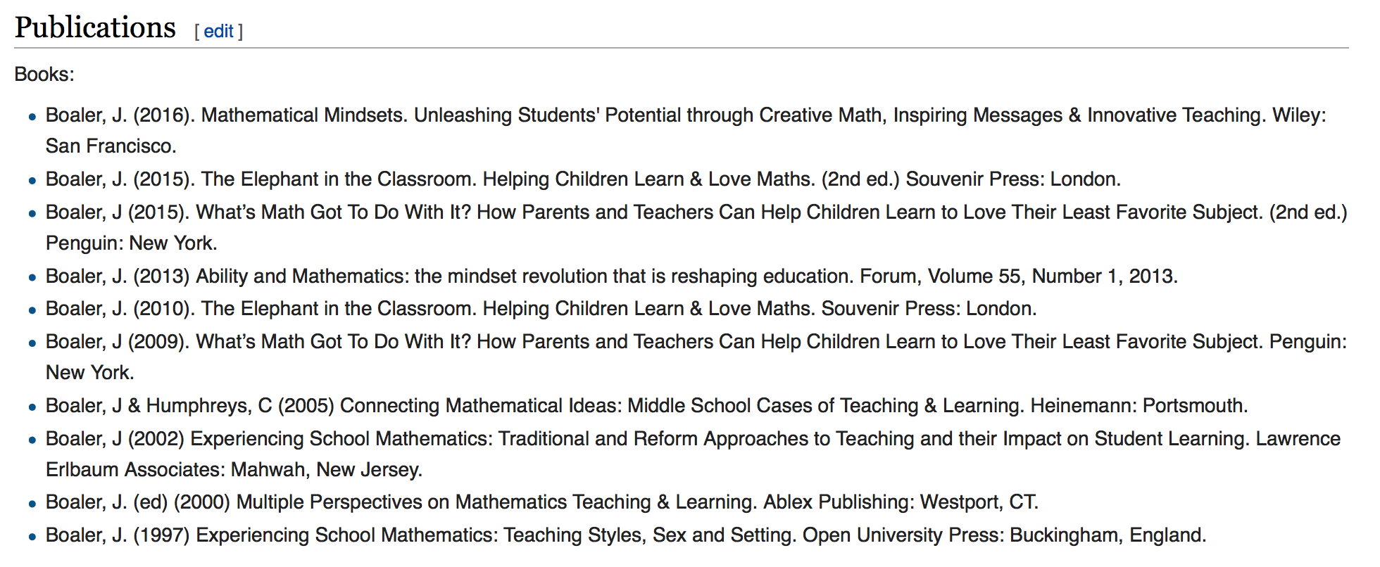
Dr. Boaler is also the author of several books (at least 10 on Education and Education reform according to Wikipedia).

Slide 88
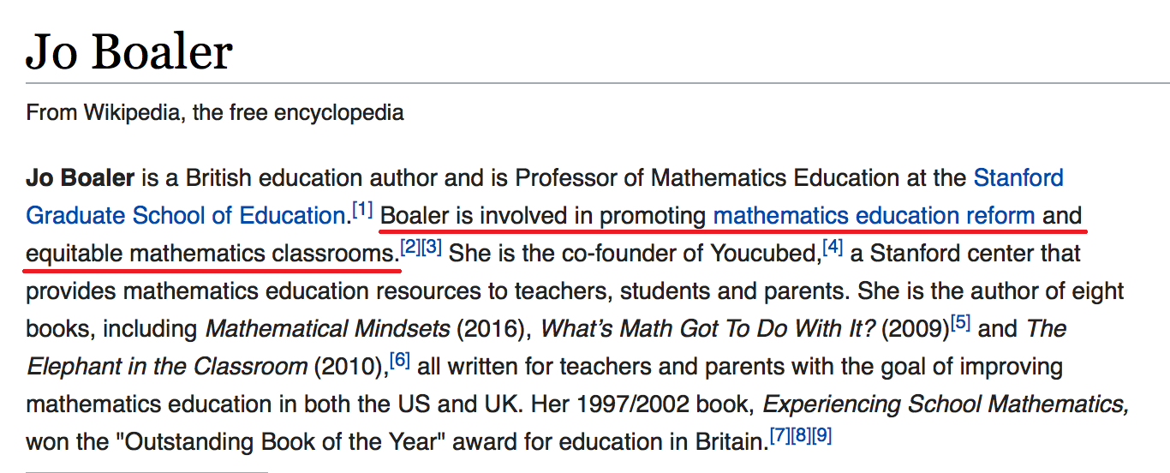
Dr. Boaler is promoting mathematics education reform and equitable mathematics classrooms. Equity to the reformers means equal outcomes, not equal opportunity!

Slide 89
Much of the “research” that reform math is successful comes from Dr. Boaler’s “research.” Specifically a paper by Boaler and Staples (an education professor at Purdue): Transforming Students’ Lives through an Equitable Mathematics Approach: The Case of Railside School. But, when that “research” is reviewed by mathematicians it is found to be lacking.

Slide 90
Here is a link to an article written by Dr. Milgram of Stanford, Dr. Bishop of California State, and statistician Paul Clopton, Veterans Affairs Medical Center (VAMC) San Diego, CA. A Close Examination of Jo Boaler’s Railside Report, by W. Bishop, P. Clopton, R.J. Milgram http://math.stanford.edu/~milgram/combined-evaluations-version3.pdf

Slide 91
In defense of Dr. Boaler, she did publish a response which can be found at the following link (Oct 2012): When Academic Disagreement Becomes Harassment and Persecution, by J. Boaler http://web.stanford.edu/~joboaler/

Slide 92
Dr. Milgram and Dr. Bishop responded… Here is the link to the response: http://math.stanford.edu/~milgram/Jo-Boaler-reveals-attacks-AccusationsResponse-trans.html Dr. Milgram goes a bit further in describing the deception of Dr. Boaler in the following article: http://math.stanford.edu/~milgram/test-build-website.html

Slide 93
The fact of the matter is that Dr. Boaler’s tests were found to be three years below the grade level being tested. This was determined by people who wrote the California standards being tested (so they are the experts).

Slide 94
And the reform math peer group that Dr. Boaler touted as doing better than their peers at the other schools that were taught with more traditional math were not the group that received her reform instruction.

Slide 95
In May of 2010, a high official in the district where Railside is located (the school that did better with reform math according to Dr. Boaler) called and updated Dr. Milgram on the situation there. One of that person’s remarks is especially relevant. It was stated that as bad as Dr. Milgram, Dr. Bishop and Clopton indicated the situation was at Railside, the school district’s internal data actually showed it was even worse.

Slide 96
The Railside district had to step in and change the math curriculum to a more traditional approach.

Slide 97
Other researchers have come to the same conclusion as Dr. Milgram and Dr. Bishop… Maybe that is why Dr. Boaler never responded to the last article in late 2012 (2 months after Dr. Boaler promised a rebuttal.)
https://educationrealist.wordpress.com/2013/01/16/jo-boalers-railside-study-the-schools-identified-kind-of/
http://oilf.blogspot.com/2013/01/educational-malpractice-for-sake-of.html?m=1

Slide 98
Dr. Milgram gets to the heart of the problem with math education; the Education Schools .

Slide 99
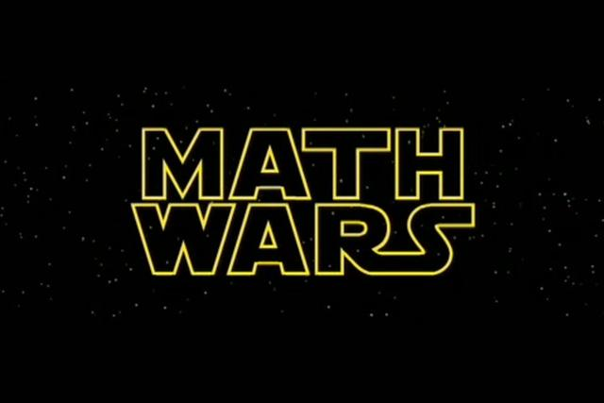
The math wars have been raging for a long time… If only it was in a galaxy far, far away…

Slide 100
Documentation of the Math Wars
David Klein’s “A Brief History of American K-12 Mathematics Education in the 20th Century.”
http://www.csun.edu/~vcmth00m/AHistory.html
H. Wu’s “Basic Skills Versus Conceptual Understanding - A Bogus Dichotomy in Mathematics Education.”
http://www.aft.org/sites/default/files/periodicals/wu.pdf

Slide 101
Ways to get in touch with me:
YouTube Channel
Republic of Texas Tackling Education Nonsense
(ROTTEN for short)
E-mail
randy.houchins@nov.com
All of the video clips in this presentation are posted on my YouTube channel.

